Slide 5

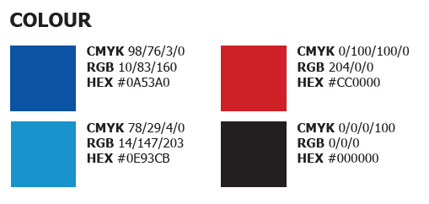



Here are some included independent digital assets and the conference branded colour guide if you would like to produce your own slide layouts. This document has been configured to automatically use the conference font Tahoma and works best with PowerPoint.

